Slide 1
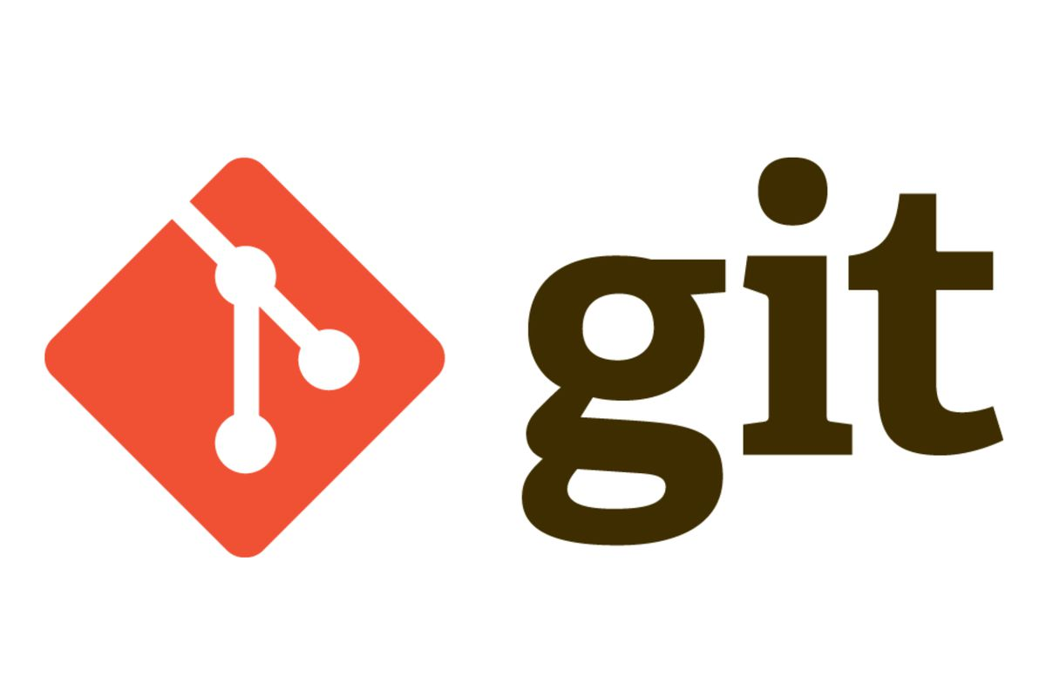
Introduction to GIT

Slide 2
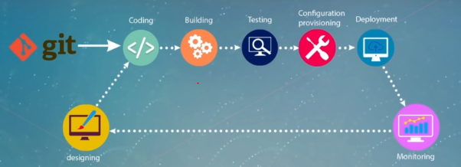
1st step of pipeline
Source code management – Which comes after designing phase which cannot be automated
Tool:
GIT – Git is a tool which enables the source code management and to process automate

Slide 3
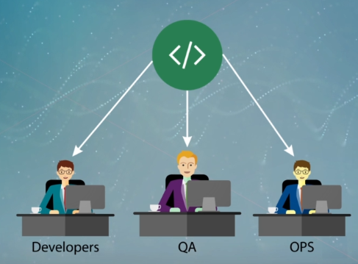
In DevOps there would be multiple stack holders who will collaborate with same code base like (Developers, QA, OPS)
Developers: Programmer wrote an application code and put it into some centralised code base
QA: Who will write test cases and put it into same code base
OPS (IT Resource): who could be writing scripts to automate the infrastructure and put into same code base
Note: we are putting all in same code base because ultimately DevOps is about collaboration

Slide 4
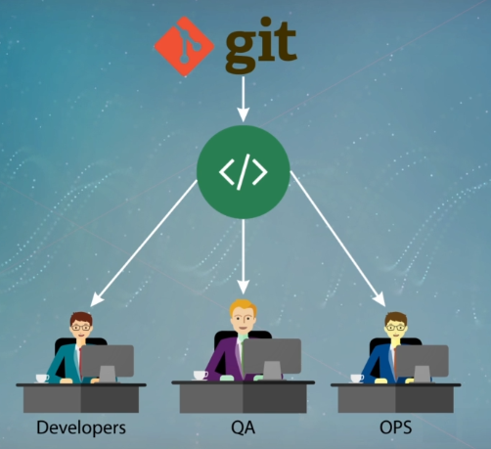
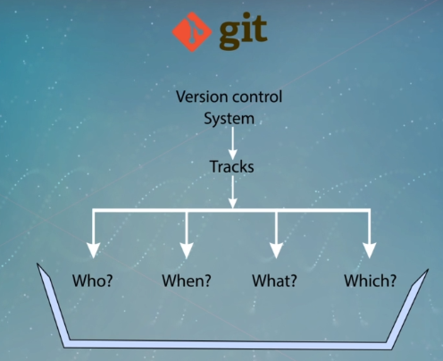
Source code management tool is a good version control system it should be robust, stable and easy to use
Why we need a version control system?
Enables you to track your files, compare over changes time,
Who: track who modified the code
When: when did they do it
What: what they had edit (who did it if any issue)
Which: which feature they had edit
Once identified we can go back to correct version i.e.., we can revert/recover back to the old state (you can recover your lost file or wrong codes)

Slide 5
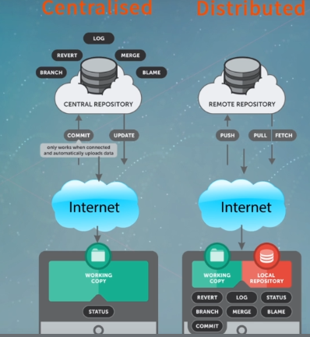
Frequently used words
Repository: It is a common code base where all the code of developers or testers or IT operators is going, that code must maintained at some centralize location which we be called as repository
What is the different feature of GIT (Distributed) than other versioning tools like CVS, Svn, Perforce (Centralised)?
Other versioning tools: (Centralised) will work on centralizes manner, for your developers to do any significance change they always need to be connected with that central repository when developers copy the code from the repository to their own system then only part of info will come to our system
Note: They cannot see the history, commit change, version history of your code
(Distributed) : Here code will be copy to our system as local repository and we can save in our own system, and we can do all activates here and push it to repository even your system is disconnected from the centralized repository

Slide 6
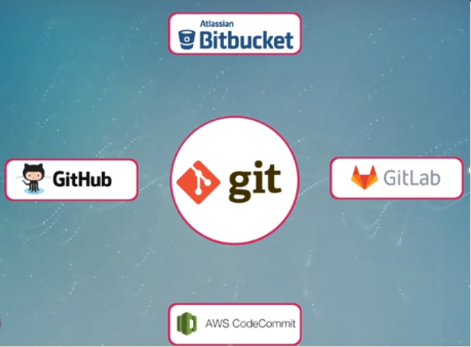
Git is a open source, you can download a Git packet (software) from the internet and start using it. Install git on your system and give access to all your collaborators
By giving git access to the source code management

Slide 7
Git: Git is a distributed version control system for tracking changes in source code during software development. It is designed for coordinating work among programmers, but it can be used to track changes in any set of files. Its goals include speed, data integrity, and support for distributed, non-linear workflows.
GitHub: GitHub is a web-based Git repository hosting service, which offers all of the distributed revision control and source code management (SCM) functionality of Git as well as adding its own features.
S.No. | Git | GitHub
1. | Git is a software. | GitHub is a service.
2. | Git is a command-line tool | GitHub is a graphical user interface
3. | Git is installed locally on the system | GitHub is hosted on the web
4. | Git is maintained by linux. | GitHub is maintained by microsoft.
5. | Git is focused on version control and code sharing. | GitHub is focused on centralized source code hosting.
6. | Git is a version control system to manage source code history. | GitHub is a hosting service for Git repositories.
7. | Git was first released in 2005. | GitHub was launched in 2008.
8. | Git has no user management feature. | GitHub has built-in user management feature.

Slide 8
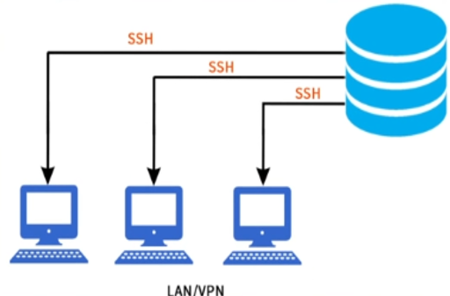
Git Works on SSH & HTTP protocol
Both SSH and HTTP are protocols are used to communicate between client and server
SSH:
SSH means "Secured Shell". It is also a secured version, where data sent between the client and server is encrypted. SSH used port 22 is used to negotiate or authenticate the connection. The remote device authentication is done by public-key cryptography. Its mode of authentication is public/private Pair, or userid/password pair.
You can host the git server in your organization at some server, all your stack holders can connect to that git server through SSH protocol

Slide 9
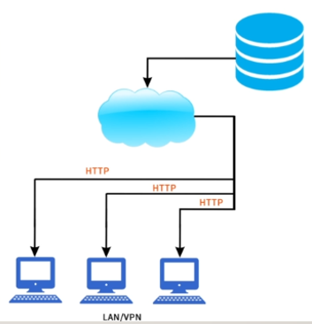
HTTP:
HTTP means Hypertext Transfer Protocol. HTTP is the underlying protocol used by the World Wide Web and this protocol defines how messages are formatted and transmitted, and what actions Web servers and browsers should take in response to various commands.
You can connect various DevOps tools through HTTP based APIs, you can host git server on web server and let others connect through HTTP based APIs
HTTPS:
It is a secure version of HTTP, where data sent between the client and server is encrypted. Now hacker when intercept those encrypted data and hackers cannot make any sense of those encrypted data and makes no sense to him and cannot reverse it. Https used port 443. Its mode of authentication is Public/Private Pair.

Slide 10
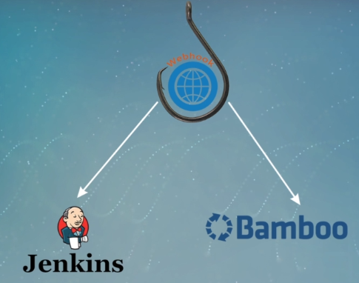
Webhook are used to notify instantly whenever any changes happened in server, if any changes happens in git hub it will the send request to client, in our scenario Jenkins is our client. git hub webhook is used in Jenkins to build the jobs whenever any changes happens in git hub code repository.
Using webhook you can connect git to any CI tools such as Jenkins and Bamboo when never there is a change on code base it inform to your CI tools that some thing has change and make them aware, according to this CI/CD team can come up to the action and face the new code base

Slide 11
Linux commands for GIT
#GIT Installation
$ yum install git
#To check GIT version
$ git –version
#to create/make a new directory
$ mkdir dirname
#to change the directory
$ cd dirname/dirpath
# To create a new file
$ vim file.txt
$ cat >file.txt
$touch file.txt
$ vim readme.md #this tells you about the description about the repository
#To check list
# ls
#ls -a
#Initilizing our working directory to git (it creates the infrastructure for making this directory as a local repository
$ git init
$cd ./git

